Slide 1
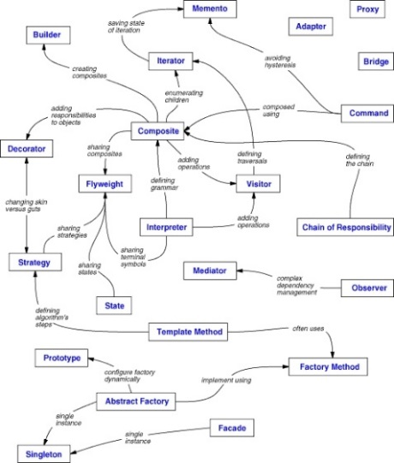
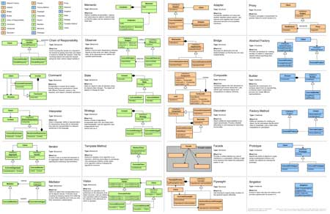
Introduction to Design Patterns
General and reusable solutions to common problems in software design
High-Quality Code
Telerik Software Academy
http://academy.telerik.com

Slide 2



What is a Design Pattern?
Name, Problem, Solution and Consequences

Slide 3
What Design Patterns Are?
General, repeatable and reusable solution to a common problem in software design
Problem/solution pairs within a given context
Aren't a finished design that can be transformed directly into code
Not code snippets
Not algorithms
Not components/libraries
Templates for solving certain OOP problems
With names to identify and talk about them

Slide 4
What Design Patterns Are? (2)
What do patterns deal with?
Application and system design
Abstractions on top of code (code structure)
Relationships between classes or other collaborators
Problems that someone already solved
Can speed up the development process by providing tested, proven development paradigms

Slide 5

Origins of Design Patterns
“Each pattern describes a problem which occurs over and over again in our environment and then describes the core of the solution to that problem, in such a way that you can use this solution a million times over, without ever doing it in the same way twice”.
Christopher Alexander
Very successful architect
A Pattern Language: Towns, Buildings, Construction, 1977
Context:
City Planning and Building architectures

Slide 6
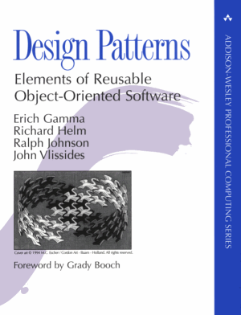
Origins of Design Patterns (2)
Search for recurring successful designs
Emergent designs from practice
Supporting higher levels of design reuse is quite challenging
Design Patterns: Elements of Reusable Object-Oriented Software
Gama, Helm, Johnson, Vlissides, 1994
Came to be known as the "Gang of Four."

Slide 7
Describing Design Patterns
Graphical notation is generally not sufficient
In order to reuse design decisions the alternatives and trade-offs that led to the decisions are critical knowledge
Concrete examples are also important
The history of the why, when, and how set the stage for the context of usage
Collaborations
Structure
Pattern name
Motivation
Participants
Known Uses
Applicability
Intent
Also Known As
Consequences
Implementation
Sample Code
Related Patterns

Slide 8


Elements of Design Patterns
Design patterns have four essential elements:
Pattern Name
Increases vocabulary
Problem
Intent, context, when to apply
Solution
UML-like structure, abstract code
Consequences
Results and tradeoffs

Slide 9

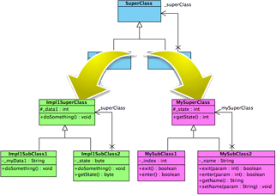
Why Design Patterns?

Slide 10
Benefits of Design Patterns
Improves system and application design
Design patterns enable large-scale reuse of software architectures
Help document how systems work
Patterns explicitly capture expert knowledge and design trade-offs
Provide a starting point for a solution
Can speed production in a team
Patterns help improve developer communication (shared language)
Pattern names form a common vocabulary

Slide 11
When to Use Patterns?
Solutions to problems that recur with variations
No need for reuse if problem only arises in one context
Solutions that require several steps:
Not all problems need all steps
Patterns can be overkill if solution is a simple linear set of instructions!
Do not use patterns when not required
Overdesign is evil!

Slide 12
Drawbacks of Design Patterns
Patterns do not lead to a direct code reuse
Patterns are deceptively simple
Teams may suffer from pattern overload
Patterns are validated by experience and discussion rather than by automated testing
Integrating patterns into the software development process is a human-intensive activity
Use patterns if you understand them well

Slide 13
Criticism of Design Patterns
Targets the wrong problem
The design patterns may just be workarounds of some missing features of a given language
Lacks formal foundations
The study of design patterns has been excessively ad-hoc
Leads to inefficient solutions
Does not differ significantly from other abstractions

Slide 14
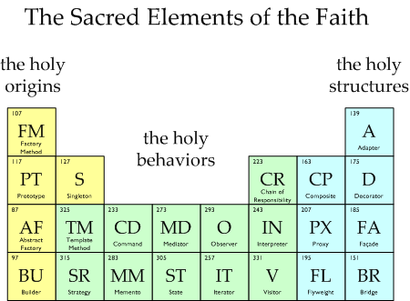
Types of Design Patterns

Slide 15
Three Main Types of Patterns
Creational patterns
Deal with initializing and configuring classes and objects
Structural patterns
Describe ways to assemble objects to implement a new functionality
Composition of classes or objects
Behavioral patterns
Deal with dynamic interactions among societies of classes and objects
How they distribute responsibility

Slide 16
Creational Patterns
Deal with object creation mechanisms
Trying to create objects in a manner suitable to the situation
Composed of two dominant ideas
Encapsulating knowledge about which concrete classes the system uses
Hiding how instances of these concrete classes are created and combined

Slide 17
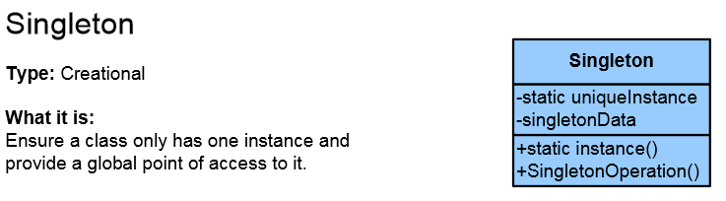
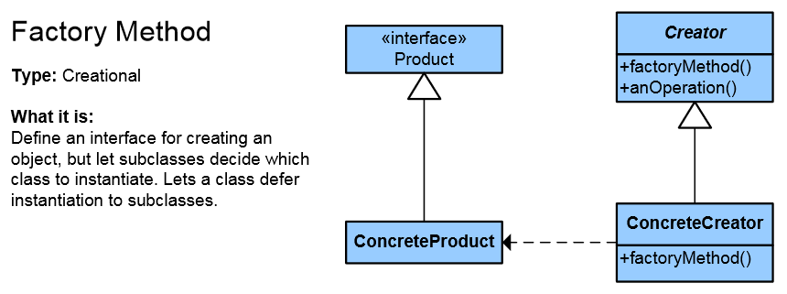
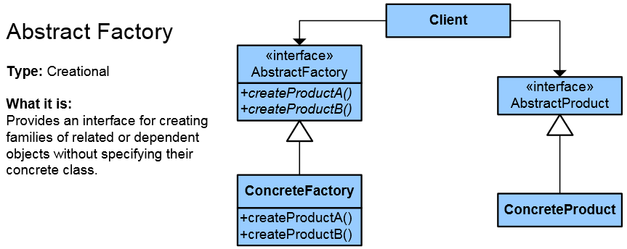
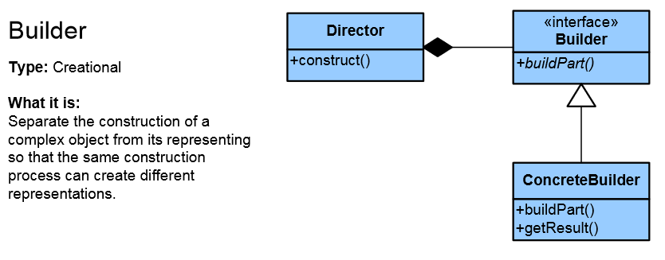
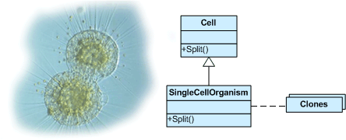
List of Creational Patterns
Singleton
Simple Factory
Factory Method
Abstract Factory
Builder
Prototype
Fluent Interface
Object Pool
Lazy initialization

Slide 18
Structural Patterns
Describe ways to assemble objects to implement a new functionality
Ease the design by identifying a simple way to realize relationships between entities
This design patterns is all about Class and Object composition
Structural class-creation patterns use inheritance to compose interfaces
Structural object-patterns define ways to compose objects to obtain new functionality

Slide 19
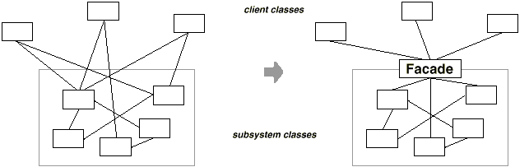
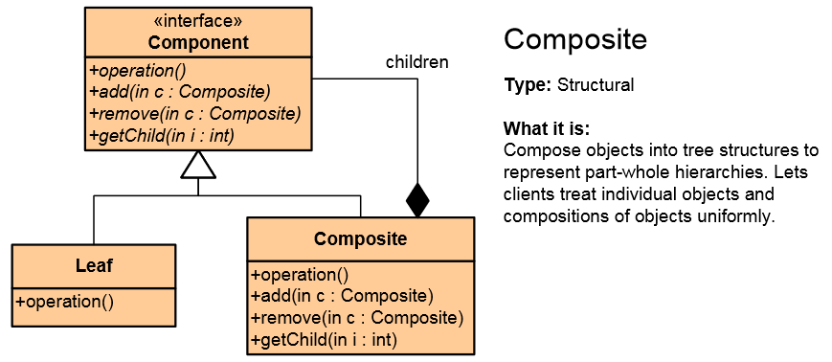
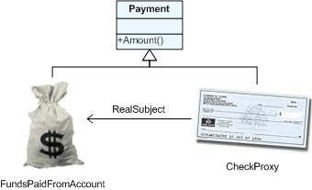
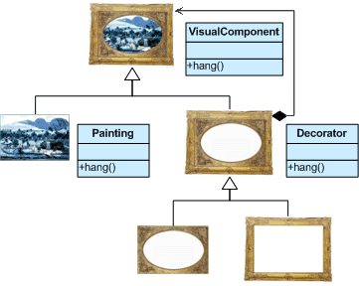
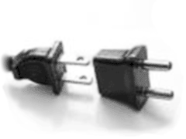
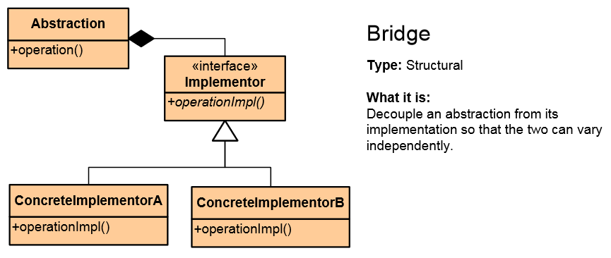
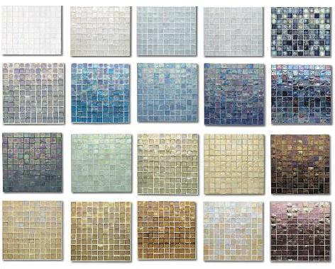
List of Structural Patterns
Façade
Composite
Flyweight
Proxy
Decorator
Adapter
Bridge

Slide 20
Behavioral Patterns
Concerned with communication (interaction) between the objects
Either with the assignment of responsibilities between objects
Or encapsulating behavior in an object and delegating requests to it
Increase flexibility in carrying out cross-classes communication

Slide 21

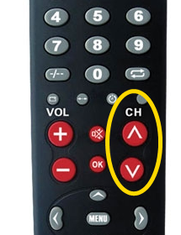
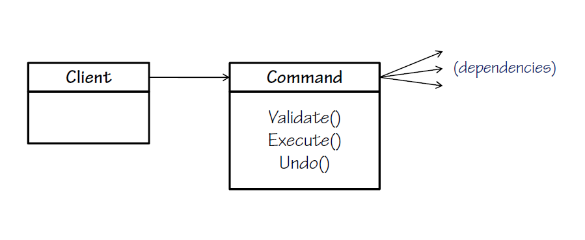
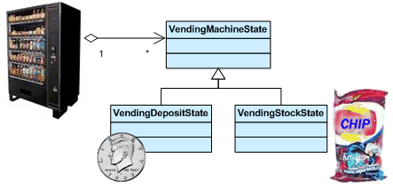
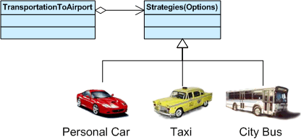
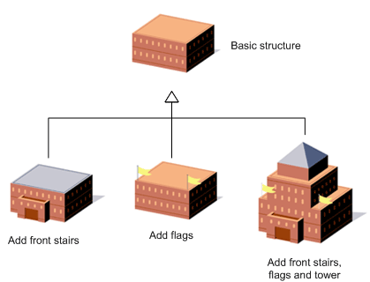
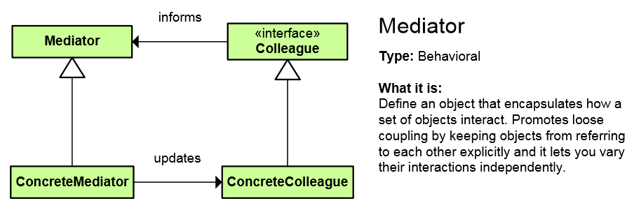
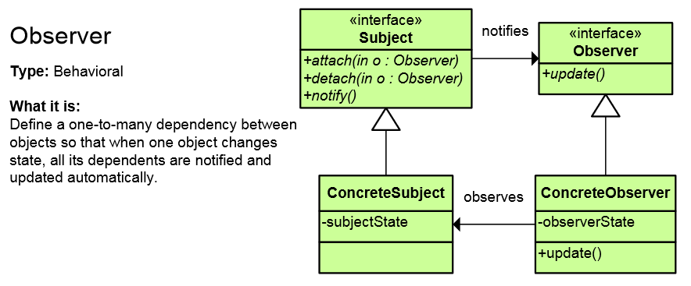
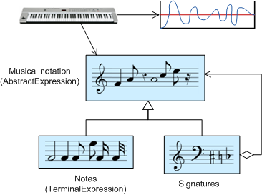
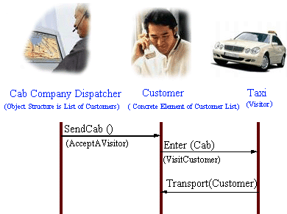
List of Behavioral Patterns
Chain of Responsibility
Iterator
Command
Template Method
Strategy
Observer
Mediator
Memento
State
Interpreter
Visitor

Slide 22
Concurrency patterns
Active Object
Double Checked Locking pattern
Monitor Object
An object to can be safely used by many threads
Read-Write Lock pattern
Thread Pool pattern
A number of threads are created to perform a number of tasks
And many more

Slide 23
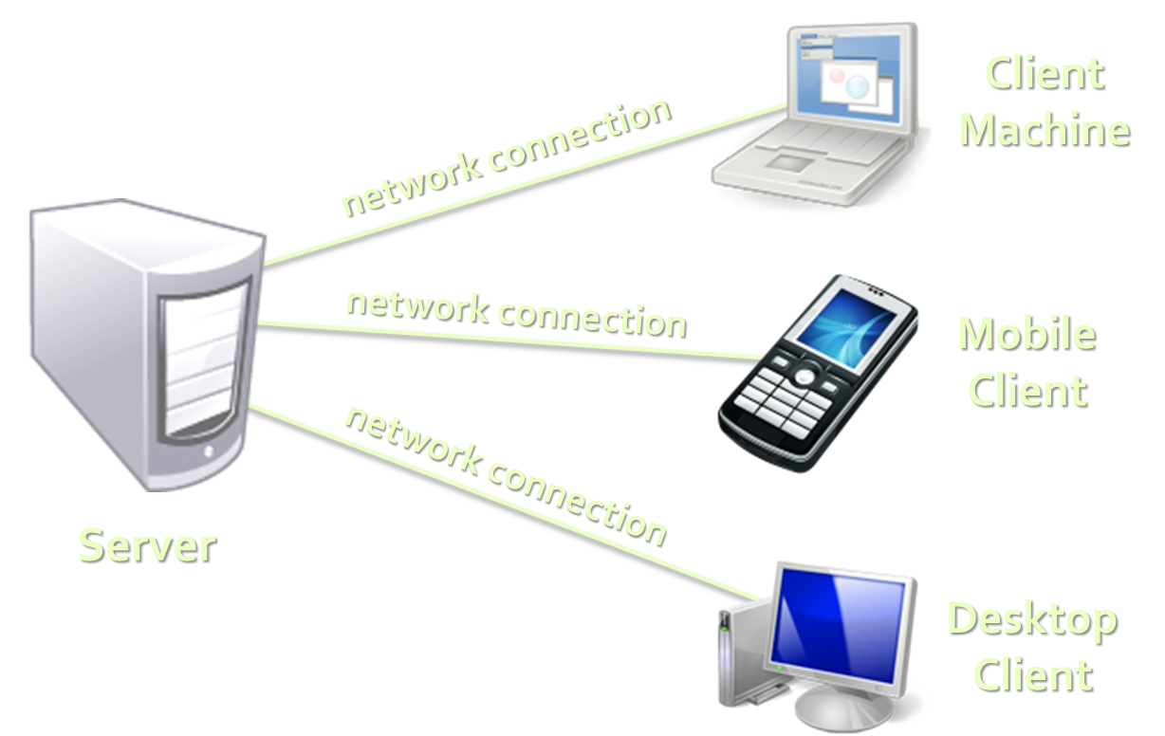
Architectural Patterns
Architectural patterns (systems design)
Client-Server Architecture
3-Tier Architecture
Client, Business and Data layers
Multi-Tier Architecture
MVC (Model-View-Controller)
MVP (Model-View-Presenter)
MVVM (Model-View-ViewModel)
SOA (Service-Oriented Architecture)
Using reusable building blocks

Slide 24
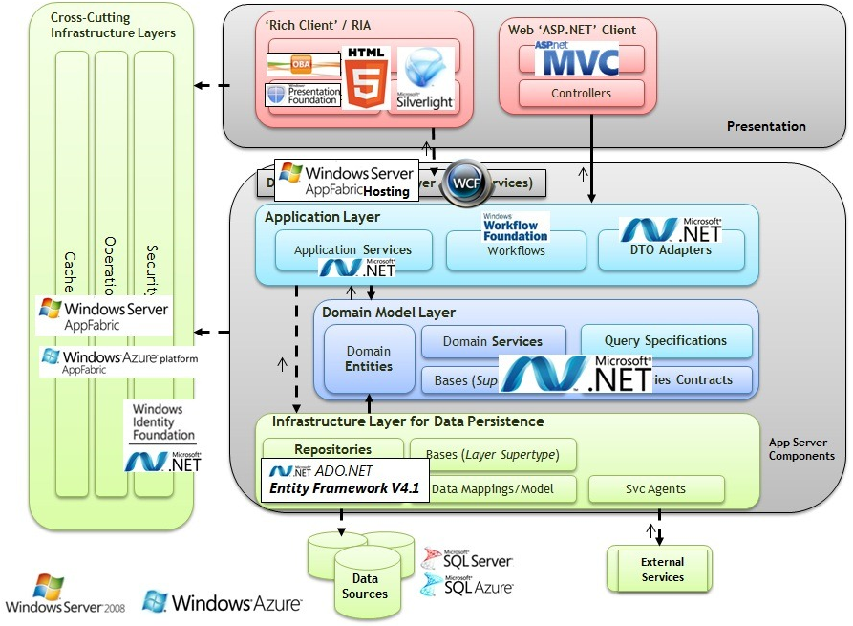
Multi-Tier Architecture

Slide 25
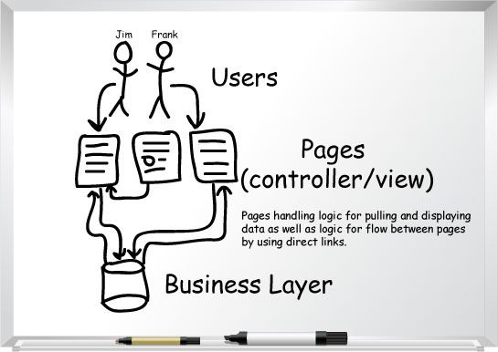
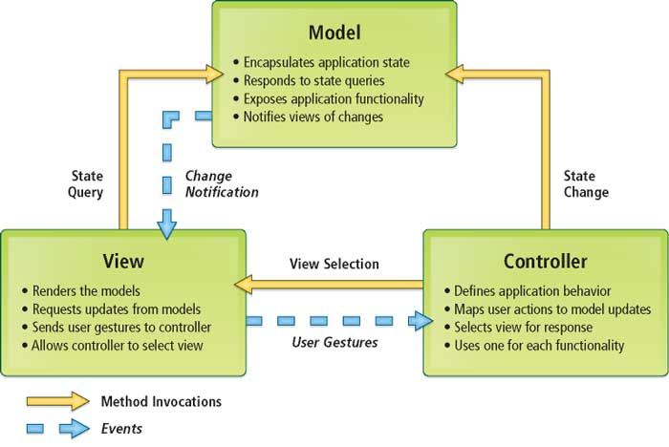
Model-View-Controller (MVC)

Slide 26
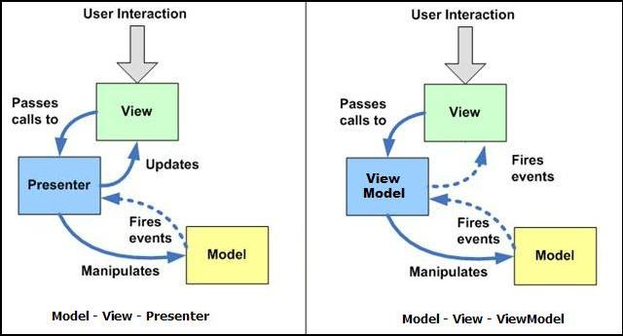
MVP vs. MVVM Patterns
MVVM is like MVP but leverages the platform's build-in bi-directional data binding mechanisms

Slide 27
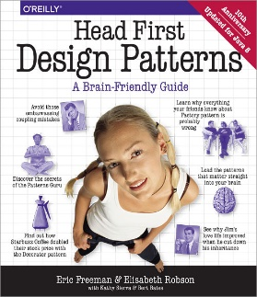


Recommended Books
Design Patterns: Elements of Reusable Object-Oriented Software, By The Gang of Four, 1994
Head First Design Patterns, By Eric Freeman, Elisabeth Robson, Bert Bates, Kathy Sierra, 2004
Refactoring to Patterns, By: Joshua Kerievsky, 2004
Patterns of Enterprise Application Architecture, Martin Fowler, 2002

Slide 28
Introduction to Design Patterns
http://academy.telerik.com

Slide 29




Free Trainings @ Telerik Academy
C# Programming @ Telerik Academy
csharpfundamentals.telerik.com
Telerik Software Academy
academy.telerik.com
Telerik Academy @ Facebook
facebook.com/TelerikAcademy
Telerik Software Academy Forums
forums.academy.telerik.com

